Slide 1



PHYSICS EQUATION SIMULATOR
STUDENTS NAME:HARISH SANJAY S,SUMITMADHAVAN S,THUTHIKATHIPATHI M,JAI GANESH JC
COLLEGE NAME:SRI SAIRAM INSTITUTE OF TECHNOLOGY
BATCH : 02
REGISTER NO :2303412414921018,2303412414911051,2303412414921054,2303412414921020
SUPERVISOR:Ms AISWARYA PRIYADHARSHINI S
UNDER THE GUIDANCE OF:Ms AISWARYA PRIYADHARSHINI S

Slide 2


JUSTIFICATION FOR SUSTAINABLE DEVELOPMENT GOAL
TITLE | PRIMARY | SECONDARY | TERITARY
GOAL | 04 | 11 | 17
TARGET | quality education | sustainable communities | partnership for the goals

Slide 3



Who we are
Name of your Venture:PHYSICS EQUATION SIMULATOR
Why ?
Explain why do you want to pursue this Business Idea.
Our motive to pursue this business idea is that we are passionate about educating students in a way where all the syllabus thought to us can be applied in real world
What ?
Provide a brief on what does your venture do.
Our venture will ensure that all the complex physics equation can be simulated in real time so that the students can grasp ideas well and deep knowledge of the related topic
How ?
Explain how your venture solves the problem and make its revenue.
Our venture solves the problem by making the students ready to apply all the equations and theories thought to them in real world applications and our venture make its revenue by subscription model or product purchase model

Slide 4
Problem/Opportunity
CONTEXT When does the problem occur? The problem occurs when the student fear the subject and studies syllabus just so they can perform well in their academics rather not focusing on the main objective of the syllabus which is to apply the tought subject in real world applications and solve real world problems | PROBLEM What is the root cause of the problem? Root cause of the problem is that the way that the subject is thought and the intimidation of an subject | ALTERNATIVES What do customers do now to ﬁx the problem? Forced to visualize or rendered videos?
CUSTOMERS Who has the problem most often? students | EMOTIONAL IMPACT How does the customer feel? Better understanding | ALTERNATIVE SHORTCOMINGS What are the disadvantages of the alternatives? run time rendering is not applicable for learning as one would need to apply the conccepts in real world problems
 | QUANTIFIABLE IMPACT What is the measurable impact (include units)? Decrease in interest in complex concepts

Slide 5

Problem Interviews And Surveys Results
How many customers did you interview?
4
What was the interview mode?
one competition and another pitch
How many of them agree this is a problem and wants a solution?
3 agreed this is a problem
How many of them said they don't need a new solution?
0 members

Slide 6
Market Size Estimation
TAM
SAM
SOM
How to calculate market size?
1. Start with Total Addressable market- Global physics students in schools and universities: ~500 million
TAM refers to the total market demand for a product or service.
If you’re entering a pre-existing space (like small business banking) you can research it and provide credible sources or reference points on how you arrived at the TAM. If you’re creating a new product or space (like Slack), you can estimate the number of customers that would want your product and approximate how much you could charge them.
2. Take your target market (SAM), within that TAM, which varies depending on geography and other logistical factors. Determine the penetration potential of your target market is 950,000 users
3.By conducting research with existing competitors, distributors etc., understand the likely penetration rate in Tamil Nadu could range from 3% to 5%
4. Multiply target market by penetration rate to find your market size if subscription is 1000Rupees/year the low estimate ₹400 million to and high estimate ₹950 million
.
Sources: ……

Slide 7

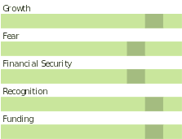
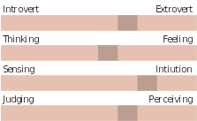
Customer Persona
OUTGOING
GREAT OBSERVER
Approachable
Motivations
Goals
To become an aeronatical engineer
Frustrations
Understands the concepts but does’nt know how to apply them in real world application
Yogesh
Age: 14-22
Occupation: Student
Location:Coimbatore
Bio
Enthusiastic about upcoming technologies and eager to learn about all the new technologies and their workings,
basic application of physics in school projects are his best works
Personality

Slide 8
Value Proposition Canvas
.
I would LOVE it if:
? What would make the customer happy?
Their ability to apply the concepts in variuos projects or personal endeavours
? What do the clients want when facing the problem?
When facing the problem the client would need the assistance of a experienced professional or other source of information
This refers to the feeling/action of customers before he gets in contact with your solution.
What do you offer that makes the customers happy?
Genuine interaction between customer that gives them what they need
What is the product or service that you are offering?
Better and easy way to visualize and represent a complex concept which is crucial to real world problems
I would WANT:
What do the clients do (actions) when facing the problem?
This refers to the feeling/action of customers before he gets in contact with your solution.
GAIN CREATORS
FIT
GAINS
PRODUCT/
SERVICE
JOBS
PAIN KILLERS
PAINS
Which features of your offering relieve the customer's pains?
real time rendering helps the student to understand the concept and be relieved of fear
relieves the customer of fear of intimidating concepts
I would HATE it if:
What are the pains of the clients when facing the problem?
This refers to the feeling/action of customers before he gets in contact with your solution.

Slide 9
Solution
Describe your Solution:
We offer Physics equation simulator
The details of our offering consist of:
Visualize of complex concepts
Simulations of the complex concepts…
Way to help students apply the syllabus in real world problems
List the Benefits of Your solutions
1.Better innovating environment
2.Resource efficient
3.Personalization

Slide 10

Competition Analysis
Benefits | PhET Interactive Simulations | Algodoo | SimScale | Khan Academy | Your Venture
Product | Interactive science simulations | Physics & mechanics simulator | Engineering physics simulations | Educational video tutorials | Real-time physics equation simulator with custom engine
Price | Free | Paid (one-time purchase) | Free with paid options | Free | Subscription model
Branding channels | Educational institutions, website | Education platforms, social media | Engineering communities | Educational institutions, website | Education forums, social media
Packaging | Web-based, easy access | Software application | Cloud-based | Web and app access | Cross-platform app (PC, mobile, web) with Vulkan support
Market reviews | Positive in educational sector | Popular for mechanics learning | Favored for advanced users | Widely used, trusted | Innovative for students seeking hands-on physics learning
UVP | Wide range of science subjects | Visual mechanics exploration | Engineering precision | Free, high-quality content | Real-time, high-performance physics engine with Vulkan
Add more as required | Customization options | Hands-on learning for mechanics | Advanced engineering tools | Interactive learning paths | Game engine-like experience, cross-platform compatibility

Slide 11
Lean Canvas
CUSTOMER SEGMENTS
Students aged 14-22, particularly those in high school and early college focused on physics.
Educational institutions and educators seeking interactive, engaging tools to enhance learning.
EARLY ADOPTERS
EXISTING ALTERNATIVES
UNIQUE VALUE PROPOSITION
UNFAIR ADVANTAGE
Hard-to-replicate knowledge in cross-platform simulation programming, allowing access on multiple devices.
Problem
SOLUTION
A cross-platform physics equation simulator that uses the Vulkan engine to provide high-quality, real-time simulations of complex physics equations.
Business Model
Tailored for students aged 14-22, helping them bridge the gap between theoretical knowledge and real-world application.
Customer Acquisition
Channels: Social media, partnerships with schools, and influencer marketing.
Target: Students (ages 14-22) and educational institutions.
Revenue Streams
Subscription Model: Monthly/annual for students.
One-Time Purchase: Lifetime access option.
Institutional Licensing: Bulk access for schools/universities.
Retention
Personalization: Tailored simulations and regular content updates.
Cross-Platform Access: Usable on any device via Vulkan, ensuring flexibility.
Community: Forum for users to share ideas and support each other.
Scalability
Low incremental costs with global reach.
Potential to expand into other STEM subjects.
Key Partnerships
Collaborate with educators, tech providers, and influencers to enhance reach and credibility.
Students struggle to understand and apply complex physics equations in real-world contexts.
Existing tools are often theoretical and lack interactive, practical application.
There is frustration among students who understand concepts but cannot apply them effectively.
KEY METRICS
"Empowering students to bring physics equations to life, making theoretical concepts practically applicable through real-time, interactive simulations."
CHANNELS
Direct sales to students and educational institutions through online educational platforms.
Subscription and purchase numbers.
User engagement (e.g., time spent using simulations).
Student improvement in comprehension and practical skills.
Traditional textbooks and online courses that teach theoretical physics concepts.
Educational apps and simulation tools, which may not offer customization or real-time applications for complex physics equations.
HIGH-LEVEL CONCEPT
Bringing physics equations to life for students to enhance real-world understanding and innovation."
Social media and digital marketing targeting students, educators, and parents.
Schools or educators interested in adopting advanced, interactive teaching resources.
REVENUE STREAMS
Subscription model (e.g., annual subscription fee for individual users).
One-time purchase option for full access.
Institutional licensing for schools or universities, allowing multiple students to benefit.
COST STRUCTURE
Development costs (software licenses, team salaries, platform fees).
Marketing and promotional expenses.
Ongoing maintenance and customer support.

Slide 12
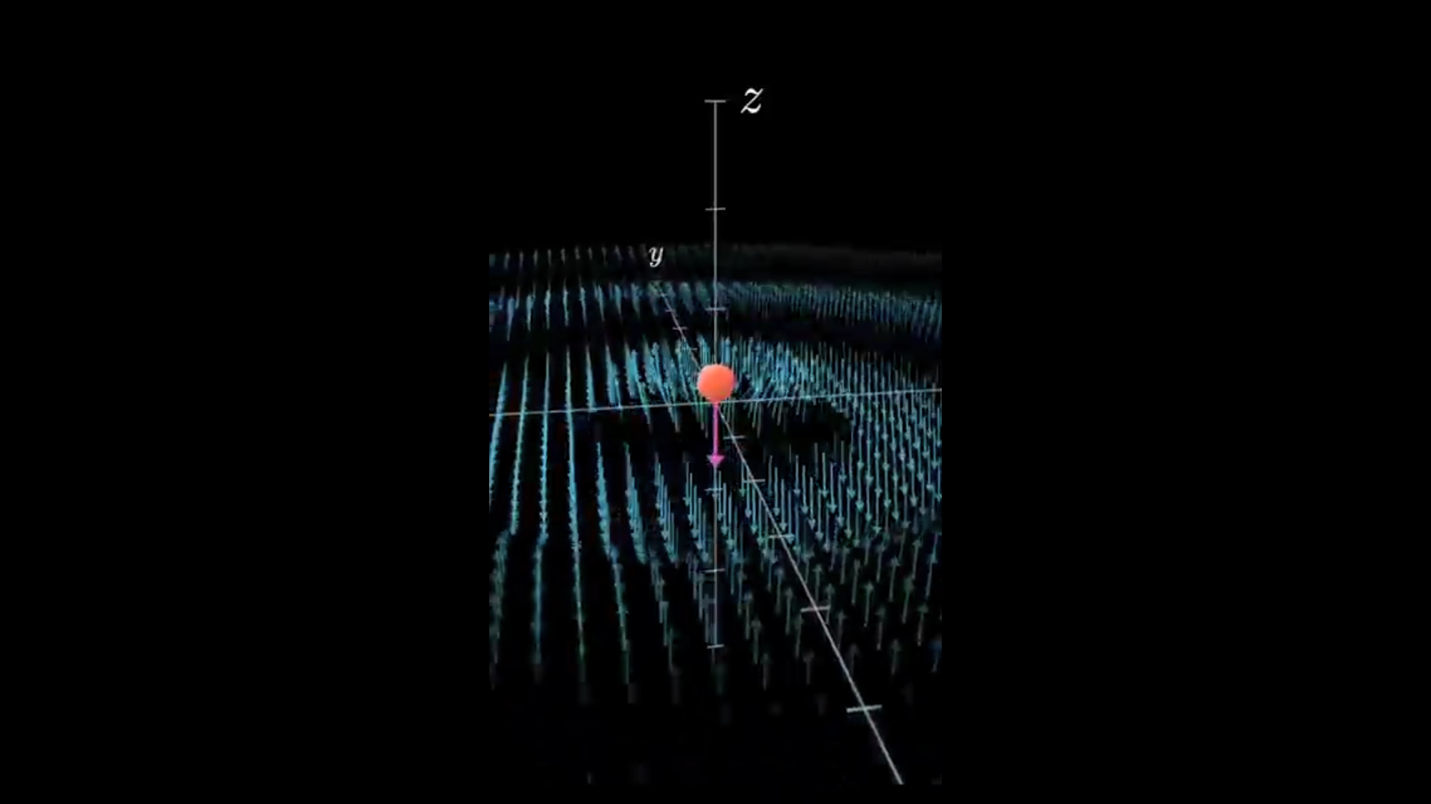
MVP

Slide 13
SALES PLAN
Customer Sales Funnel
Customer Acquisition Plan
TARGET MARKET:
students and teachers
LEADS:
university
OPPORTUNITIES/PROSPECTS:
Learnning opportunities
CUSTOMER:
students
1 | 2 | 3 | 4 | 5
Target Customer Segment (Type) | Target Customer Segment (Number) | Channels to be used to attract the target customer segment | Estimated number of leads | Estimated cost to convert these leads to actual customers
dept HOD | - | showing progress | >100 | 22,000
An student | 73393 43106 | product | 1 | 0
university | - | complete product | >2000 | 57,000

Slide 14
Go-to-Market Strategy
Social Media Presence: Establish accounts on Facebook, LinkedIn, Instagram, and Twitter. Regularly post educational content, tutorials, and user testimonials.
Branding Video: Create a 1-2 minute video that highlights the product, showcasing its unique value of making physics learning more practical and interactive. The video should include:
What the simulator is
The target audience (students and educators)
Key benefits: interactive, real-time simulations, and easy-to-use interface
Positioning Statement: “Physics Equation Simulator is designed for students and educators to simplify and visualize complex physics concepts, helping bridge the gap between theory and practical application.”

Slide 15
FINANCIAL PLAN
Start-up Costs

Slide 16
Forecast P&L

Slide 17
Financial Projections

Slide 18
UNIT ECONOMICS

Slide 19
Funding Plan
How much funds required to reach to the next level of the venture?
3,00,000
How much have been bootstrapped? If not, why ?
1,000,not much since the state the start up is at early research phase
How much can be bootstrapped?
12,000
How much external funding required? If not, why?
12,00,000
Funds utilization strategy (Details)
Software & Licenses
Cloud Computing,GPU Resources
Bug Fixes & Optimization
Building an Intuitive UI
Support for Different Devices
Documentation & Tutorials
Social Media & Outreach
Partnerships & Collaborations – Universities, research institutions, or ed-tech companies.
Customer Support
One-Time License Fee
Ads & Sponsorships

Slide 20
Thank You!

